Slide 1

Music Reactive LED Strip
IOT PROJECT REVIEW 2

Slide 2
Table of Contents
01
02
03
04
Abstract
Progress So far
Project working
Code

Slide 3
Abstract
The user's music listening experience is improved by this project by adding and
putting images in time with the music.
The study uses computer analysis to examine playing back music and controls LEDs to create a visual effect.
This report provides a summary of the data and using expertise to produce a wireless, portable music reactive LED proof of concept system for illumination.

Slide 4
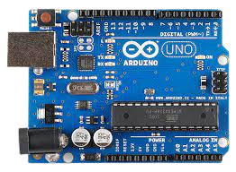
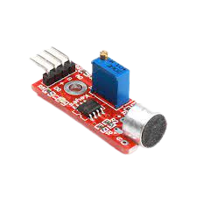
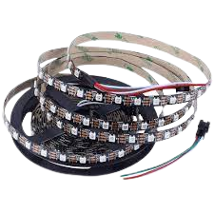
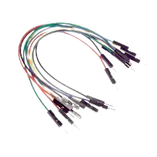
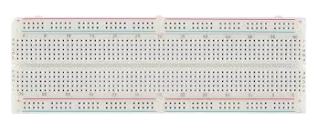
Components used
Arduino Uno R3
WS2812B LED Strip
Sound Detection Sensor Module
Breadboard
Jumper Wires
12 V DC Adaptor

Slide 5
Progress so far
We have constructed a sound reactive system using Arduino uno, sound sensor and led. Everytime it hears a sound it responds to it by glowing.
We plan to replace the led with a LED strip and tinker the code a little bit to make it music reactive

Slide 6
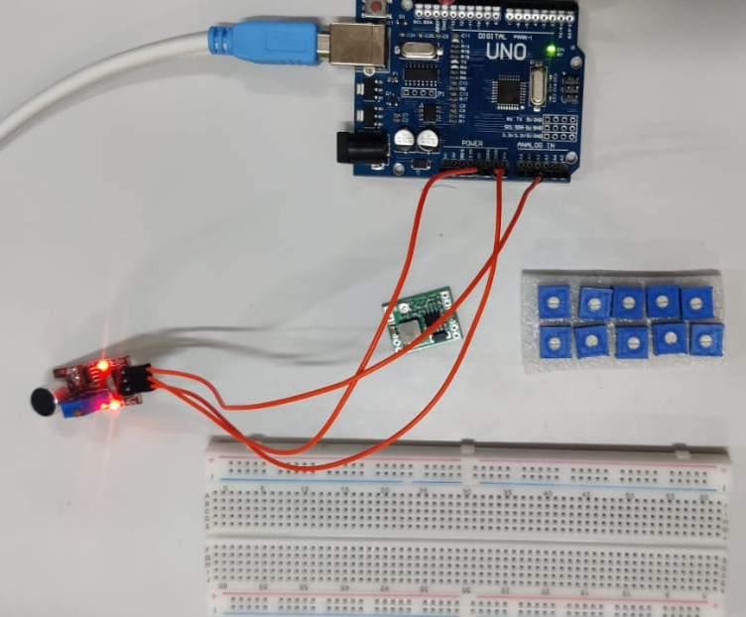
Project

Slide 7
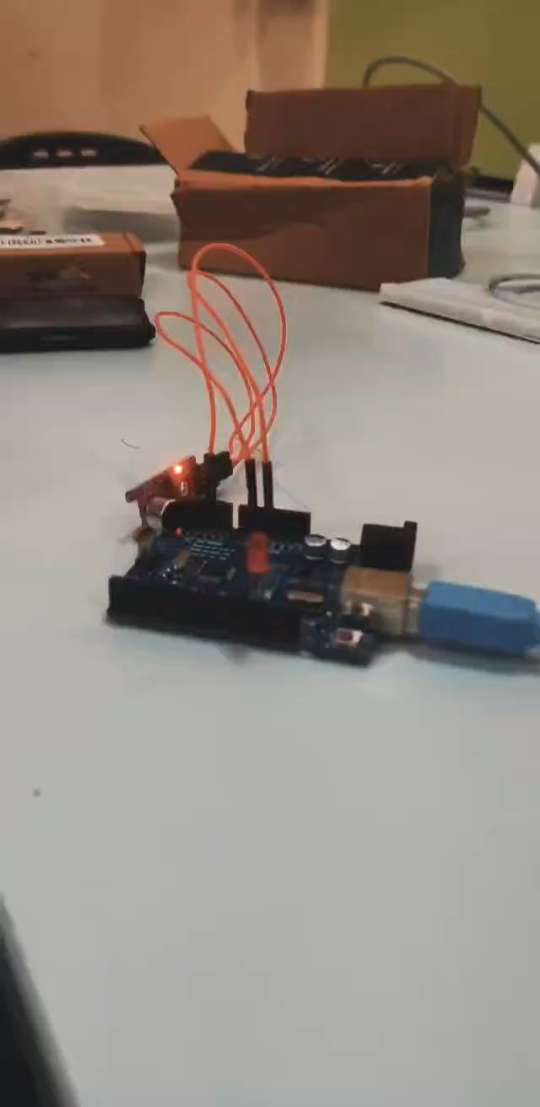
Video

Slide 8
Code
const int ledpin=13;
const int soundpin=A2;
const int threshold=500;
void setup()
{
Serial.begin(9600);
pinMode(ledpin,OUTPUT);
pinMode(soundpin,INPUT);
}
void loop()
{
digitalWrite(ledpin,LOW);
int soundsens=analogRead(soundpin);
if (soundsens>=threshold) {
digitalWrite(ledpin,HIGH);
delay(10);
}
else{
digitalWrite(ledpin,LOW);
}
}

Slide 9
Team members
Akila Bala 20MIA1052
Nithin Kodipyaka 20MIA1075
Manish Aniruddha P-20MIA1078

